Slide 1


RICTOR Domain Diagram H.Sapiens Reference
57
439
743
857
1084
1190
RICTORN
RICTORM
RasGEF
Domain5
RICTOR Phosphorylation
523
742
926
992
ARM-Repeats

Slide 2
57
439
743
857
1084
1190
RICTORN
RICTORM
RasGEF
Domain5
RICTOR Phosphorylation
523
742
926
992
ARM-Repeats

Slide 3
Secondary Endosymbiosis Event
SAR
Amorphea
Archaeplastida
Ciliates
Ochrophyta
Alveolata
Apusomonada
Chlorophyta
Stramenopiles
Breviates
Streptophyta
Rhizaria
Rhodophyta
Opisthokonta
Amoebozoa
Discoba
Secondary Endosymbiosis Event
Metamonada
Euglena gracilis
Primary Endosymbiosis
Event
Excavata

Slide 4
TOR Complex 1
TOR Complex 2
RICTOR
RAPTOR
TOR
SIN1
TOR
LST8
LST8

Slide 5
Workflow/Pipeline
NCBI/JGI Genomic Information
MSA
Phylogenetic Tree(s)
Results/TOR Complex Patterns
BUSCO/HMMER/BLAST
R Tables & Taxonomy Tables
Graphs/Data Table
SRA /Diamond Alignment
Notes:
We need to add a start point. Have something that asks the question; what organisms have TORC2 Components and TORC1 Components?

Slide 6


Slide 7
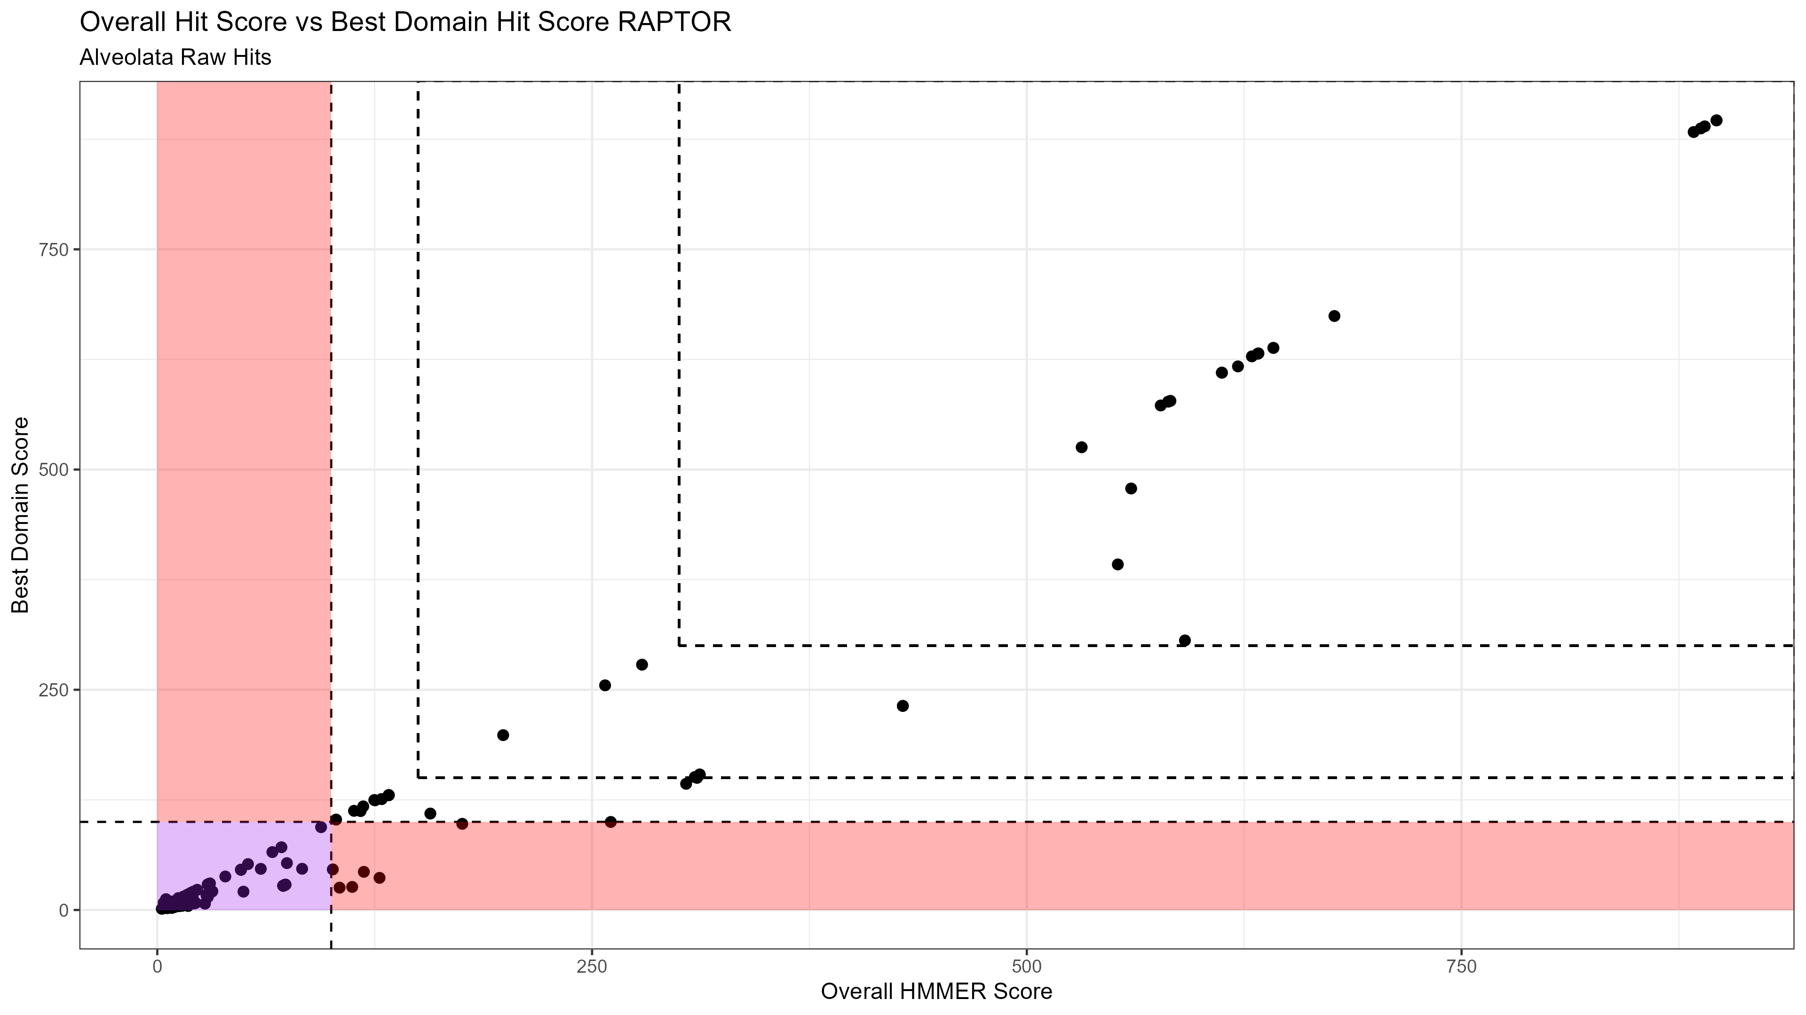

Slide 8
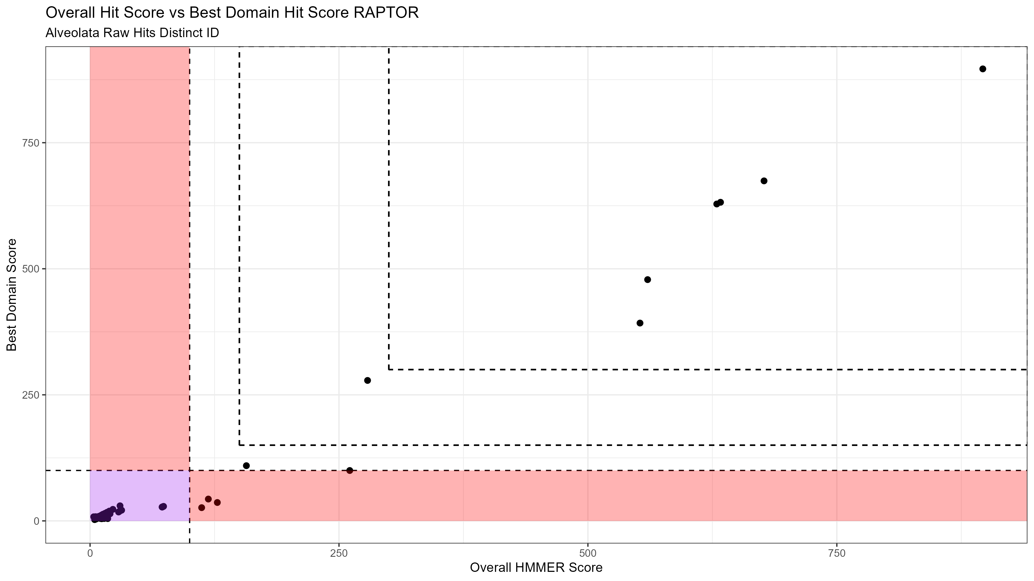

Slide 9


Slide 10


Slide 11
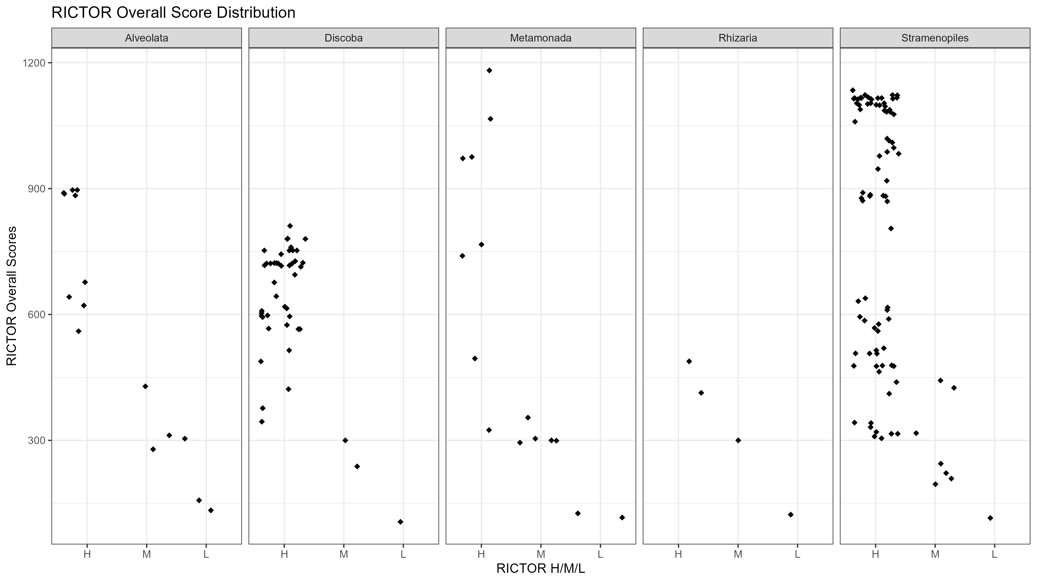

Slide 12
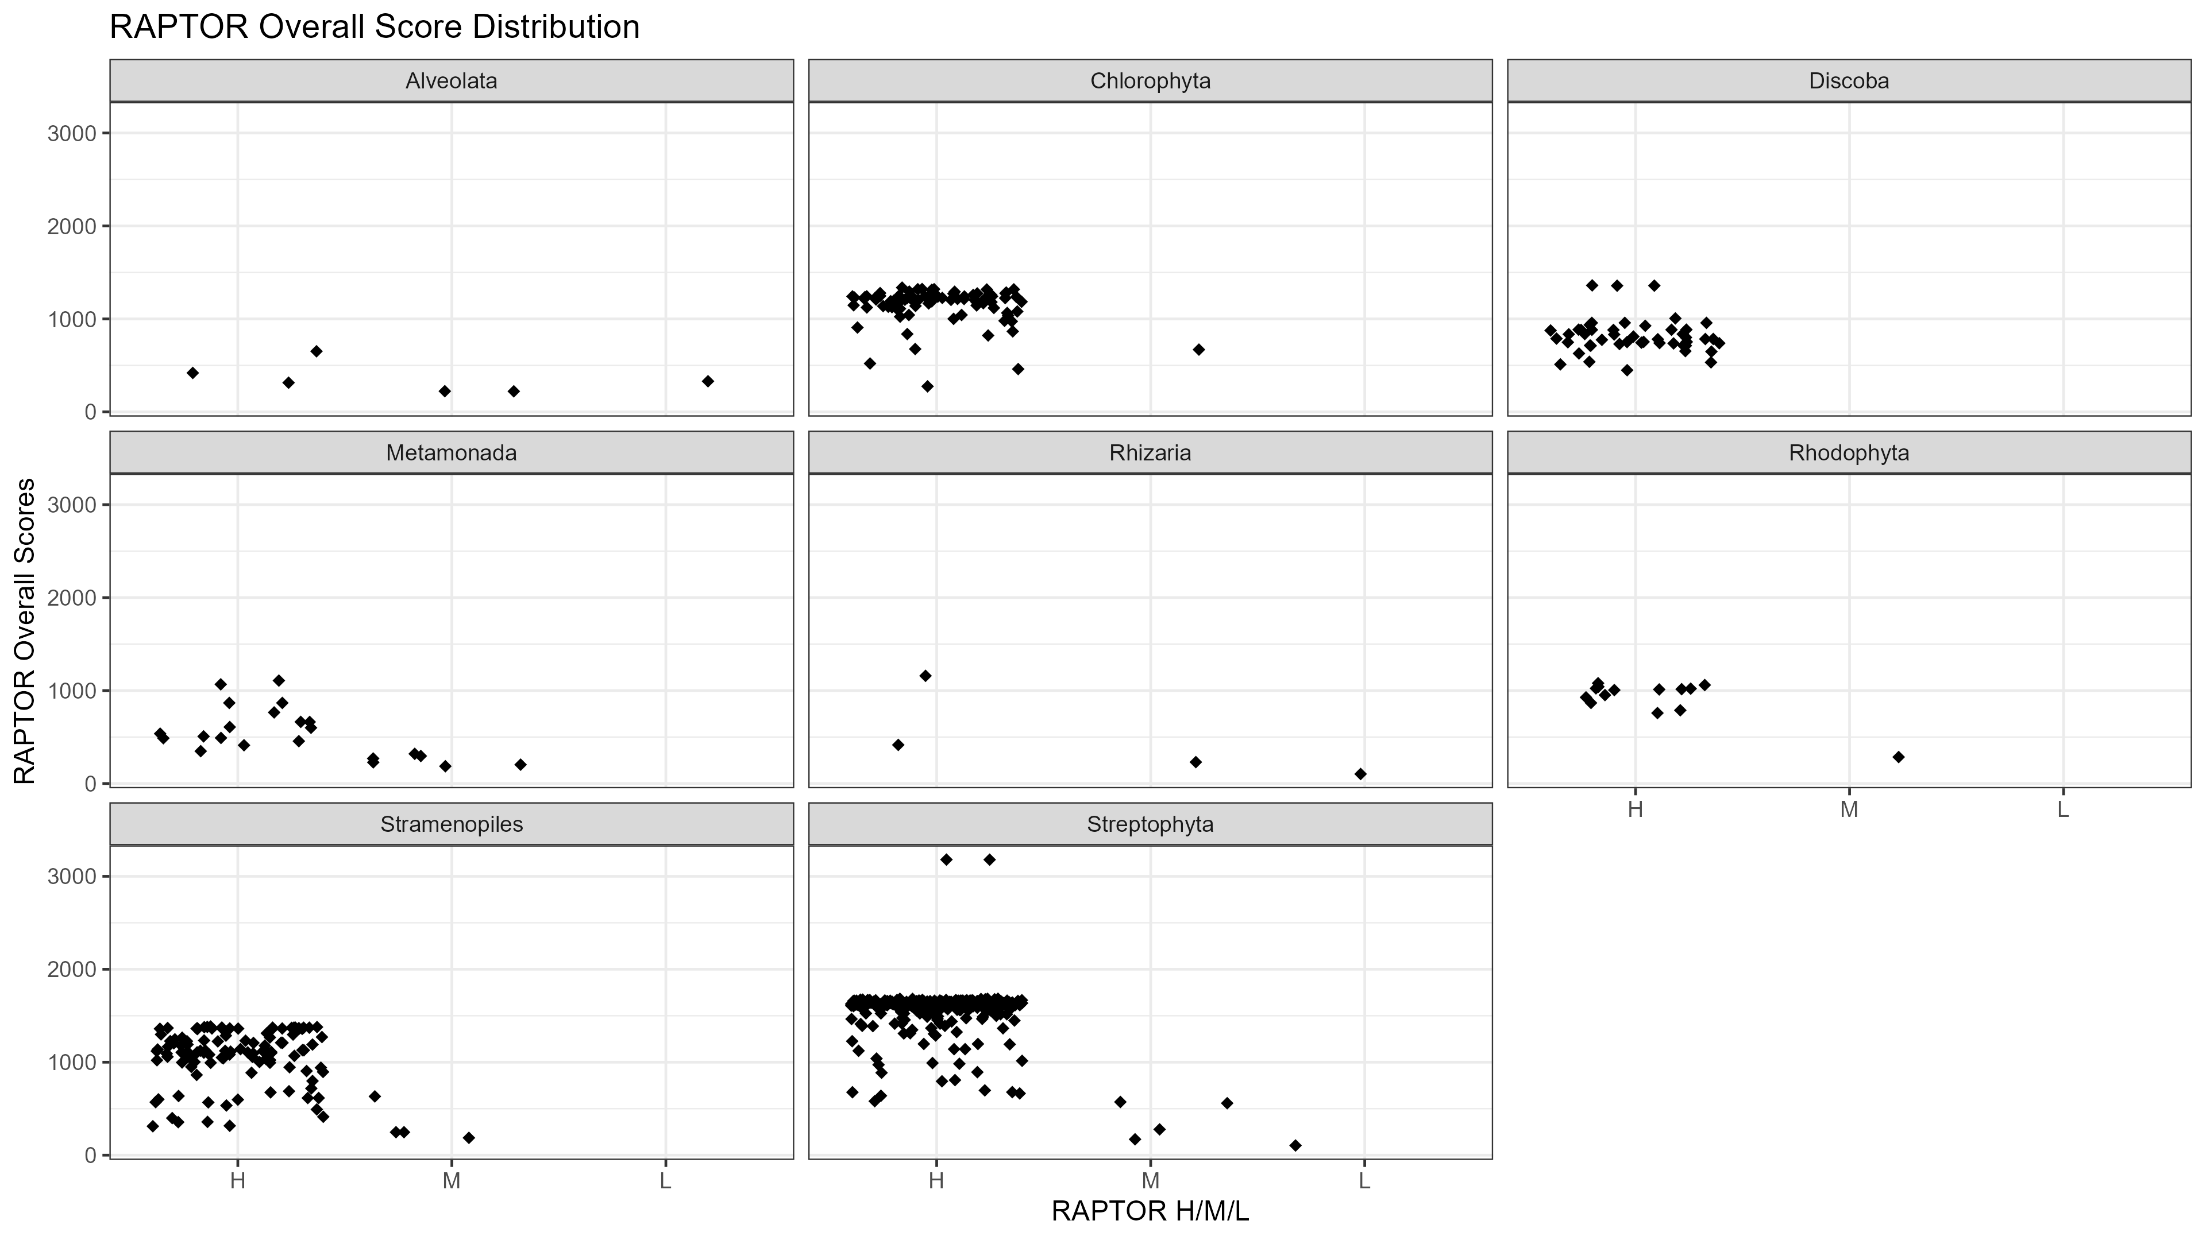

Slide 13

Metamonada
Opisthokonta
Amoebozoa
Discoba
Rhizaria
Streptophyta
Alveolata
Stramenopila
Rhodophyta
Chlorophyta

Slide 14

Stramenopiles Phylogenetic Tree
With HMMER Score Map
SIN1
RICTOR
RAPTOR
LST8
TOR
Cylindrotheca closterium
Nitzschia inconspicua
Nitzschia putrida
Pseudo-nitzschia multiseries
Pseudo-nitzschia multistriata
Fragilariopsis cylindrus CCMP1102
Entomoneis
Phaeodactylum tricornutum CCAP 1055/1
Seminavis robusta
Fistulifera solaris
Mayamaea pseudoterrestris
Cyclotella cryptica
Thalassiosira oceanica CCMP1005
Thalassiosira pseudonana CCMP1335
Conticribra weissflogii
Completeness Score
Skeletonema marinoi
Chaetoceros tenuissimus
Fragilaria crotonensis
100
Ectocarpus siliculosus
Ectocarpus sp. CCAP 1310/34
Cladosiphon okamuranus
90
Nemacystus decipiens
Alaria esculenta
Undaria pinnatifida
80
Macrocystis pyrifera
Saccharina japonica
Sargassum fusiforme
70
Tribonema minus
Pelagomonas calceolata
Aureococcus anophagefferens
Chrysophaeum taylorii
60
Pelagophyceae sp. CCMP2097
Paraphysomonas imperforata
Ochromonas sp. CCMP1393
50
Vischeria
Nannochloropsis sp.
Nannochloropsis gaditana CCMP526
40
Nannochloropsis oceanica
Nannochloropsis salina CCMP1776
Metabolic Strategy
Monodopsis
Triparma columacea
Triparma strigata
Triparma verrucosa
Triparma laevis f. inornata
Autotrophic
Triparma laevis f. longispina
Triparma retinervis
Tetraparma gracilis
Parmales sp. scaly parma
Heterotroph
Bremia lactucae
Plasmopara halstedii
Phytophthora capsici
Phytophthora cinnamomi var. cinnamomi
Mixotroph
Phytophthora infestans T30-4
Phytophthora nicotianae CJ01A1
Phytophthora nicotianae P10297
Phytophthora nicotianae P1569
Parasite
Phytophthora nicotianae P1976
Phytophthora megakarya
Phytophthora palmivora
Endosymbiotic
Phytophthora cactorum
Phytophthora fragariae
Phytophthora idaei
Phytophthora sojae
Phytophthora boehmeriae
Phytophthora rubi
HMMER Score
Phytophthora ramorum
Phytophthora kernoviae 00238/432
Phytophthora aleatoria
Peronospora destructor
H
Peronospora farinosa
Peronospora effusa
Peronospora belbahrii
Peronospora matthiolae
M
Hyaloperonospora brassicae
Hyaloperonospora arabidopsidis Emoy2
Lagenidium giganteum
Pythium oligandrum
L
Pythium insidiosum
Globisporangium splendens
[Pythium] brassicae (nom. inval.)
Albugo candida
P
Thraustotheca clavata
Aphanomyces euteiches
Aphanomyces astaci
Aphanomyces cochlioides
NA
Aphanomyces invadans
Saprolegnia parasitica CBS 223.65
Saprolegnia diclina VS20
Achlya hypogyna
Blastocystis sp. ATCC 50177/Nand II
Blastocystis sp. subtype 4
Blastocystis sp. Blastoise
Blastocystis sp. BT1
Blastocystis sp. DL
Blastocystis sp. JDR
Blastocystis sp. NMH
Aplanochytrium kerguelense
Aurantiochytrium limacinum ATCC MYA-1381
Schizochytrium aggregatum ATCC 28209
Hondaea fermentalgiana
Hyphochytrium catenoides

Slide 15
Alveolata and Rhizaria Phylogenetic Tree
With HMMER Score Map
SIN1
RICTOR
RAPTOR
LST8
TOR
Perkinsus olseni
Perkinsus chesapeaki
Perkinsus marinus ATCC 50983
Symbiodinium microadriaticum
Symbiodinium sp. KB8
Symbiodinium sp. CCMP2592
Symbiodinium natans
Durusdinium trenchii
Breviolum minutum
Cladocopium goreaui
Effrenium voratum
Fugacium kawagutii
Polarella glacialis
Amoebophrya sp. AT5.2
Amoebophrya sp. A120
Chromera velia CCMP2878
Vitrella brassicaformis CCMP3155
Eimeria acervulina
Eimeria tenella
Completeness Score
Eimeria maxima
Eimeria brunetti
Cyclospora cayetanensis
Cryptosporidium parvum Iowa II
100
Cryptosporidium felis
Cryptosporidium meleagridis
Cryptosporidium andersoni
Cryptosporidium canis
Cryptosporidium hominis
Cryptosporidium bovis
Cryptosporidium muris RN66
75
Cryptosporidium ryanae
Cryptosporidium xiaoi
Cryptosporidium tyzzeri
Cryptosporidium ubiquitum
Cryptosporidium sp. chipmunk genotype I
Cryptosporidium sp. 43IA8
50
Toxoplasma gondii VEG
Toxoplasma gondii GT1
Toxoplasma gondii ME49
Toxoplasma gondii VAND
Toxoplasma gondii RUB
Toxoplasma gondii MAS
25
Toxoplasma gondii p89
Toxoplasma gondii CAST
Toxoplasma gondii FOU
Toxoplasma gondii ARI
Toxoplasma gondii GAB2-2007-GAL-DOM2
Toxoplasma gondii TgCatPRC2
Besnoitia besnoiti
Hammondia hammondi
Cystoisospora suis
Neospora caninum Liverpool
Metabolic Strategy
Gregarina niphandrodes
Porospora cf. gigantea A
Plasmodium berghei ANKA
Plasmodium chabaudi adami
Plasmodium chabaudi chabaudi
Autotrophic
Plasmodium vinckei vinckei
Plasmodium vinckei brucechwatti
Plasmodium vinckei lentum
Plasmodium vinckei petteri
Plasmodium yoelii yoelii
Plasmodium yoelii 17X
Heterotroph
Plasmodium brasilianum
Plasmodium knowlesi strain H
Plasmodium vivax Brazil I
Plasmodium vivax North Korean
Mixotroph
Plasmodium vivax Mauritania I
Plasmodium vivax India VII
Plasmodium fragile
Plasmodium malariae
Plasmodium ovale curtisi
Parasite
Plasmodium ovale wallikeri
Plasmodium gonderi
Plasmodium cynomolgi strain B
Plasmodium inui San Antonio 1
Plasmodium falciparum CAMP/Malaysia
Endosymbiotic
Plasmodium falciparum NF54
Plasmodium falciparum 3D7
Plasmodium falciparum 7G8
Plasmodium falciparum Dd2
Plasmodium falciparum Palo Alto/Uganda
Plasmodium falciparum HB3
Plasmodium falciparum RAJ116
HMMER Score
Plasmodium falciparum IGH-CR14
Plasmodium falciparum Vietnam Oak-Knoll (FVO)
Plasmodium falciparum FCH/4
Plasmodium falciparum Tanzania (2000708)
Plasmodium falciparum NF135/5.C10
Plasmodium falciparum MaliPS096_E11
H
Plasmodium falciparum UGT5.1
Plasmodium reichenowi
Plasmodium gaboni
Plasmodium sp. DRC-Itaito
Plasmodium sp. gorilla clade G1
M
Plasmodium sp. gorilla clade G2
Plasmodium sp. gorilla clade G3
Plasmodium gallinaceum
Plasmodium relictum
Hepatocystis sp. ex Piliocolobus tephrosceles
L
Babesia bigemina
Babesia ovis
Babesia caballi
Babesia gibsoni
Babesia ovata
P
Babesia duncani
Babesia sp. Xinjiang
Babesia bovis T2Bo
Babesia microti strain RI
NA
Theileria annulata
Theileria orientalis strain Shintoku
Theileria parva strain Muguga
Theileria equi strain WA
Cardiosporidium cionae
Paramecium primaurelia
Paramecium tetraurelia strain d4-2
Paramecium octaurelia
Paramecium pentaurelia
Paramecium sonneborni
Ichthyophthirius multifiliis
Tetrahymena thermophila SB210
Pseudocohnilembus persalinus
Stylonychia lemnae
Oxytricha trifallax
Blepharisma stoltei
Plasmodiophora brassicae
Bonamia ostreae
Reticulomyxa filosa
Lotharella oceanica
Bigelowiella natans CCMP2755
Paulinella micropora

Slide 17
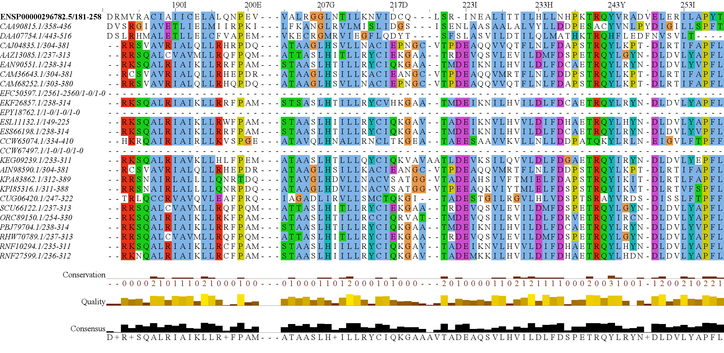
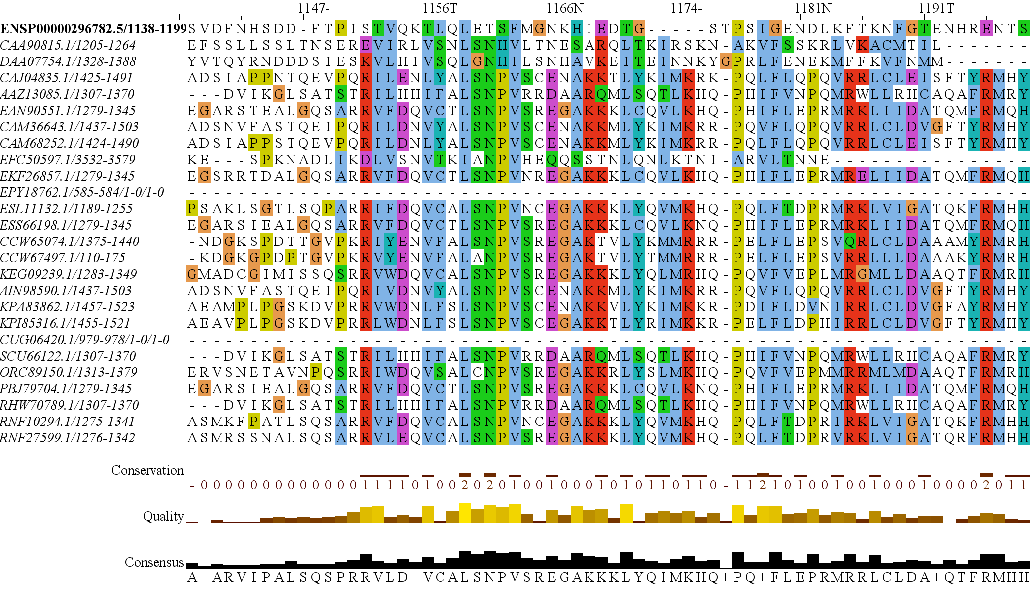
RICTORN
RICTORM
RasGEF
Domain5
RICTOR Phosphorylation
ARM Repeats

Slide 18
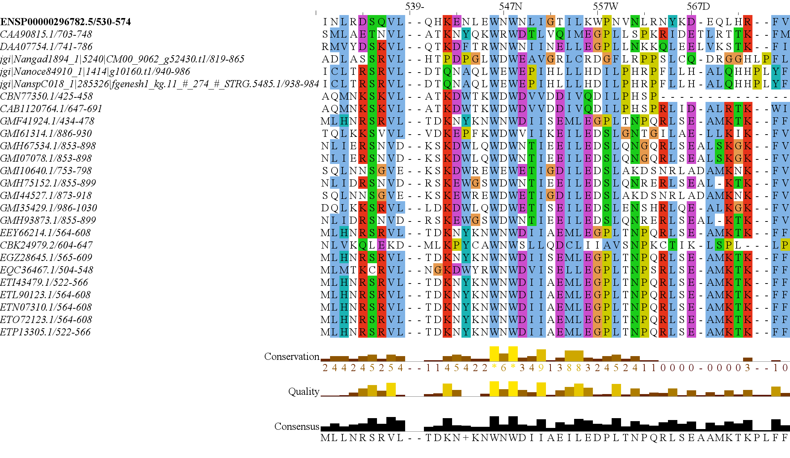
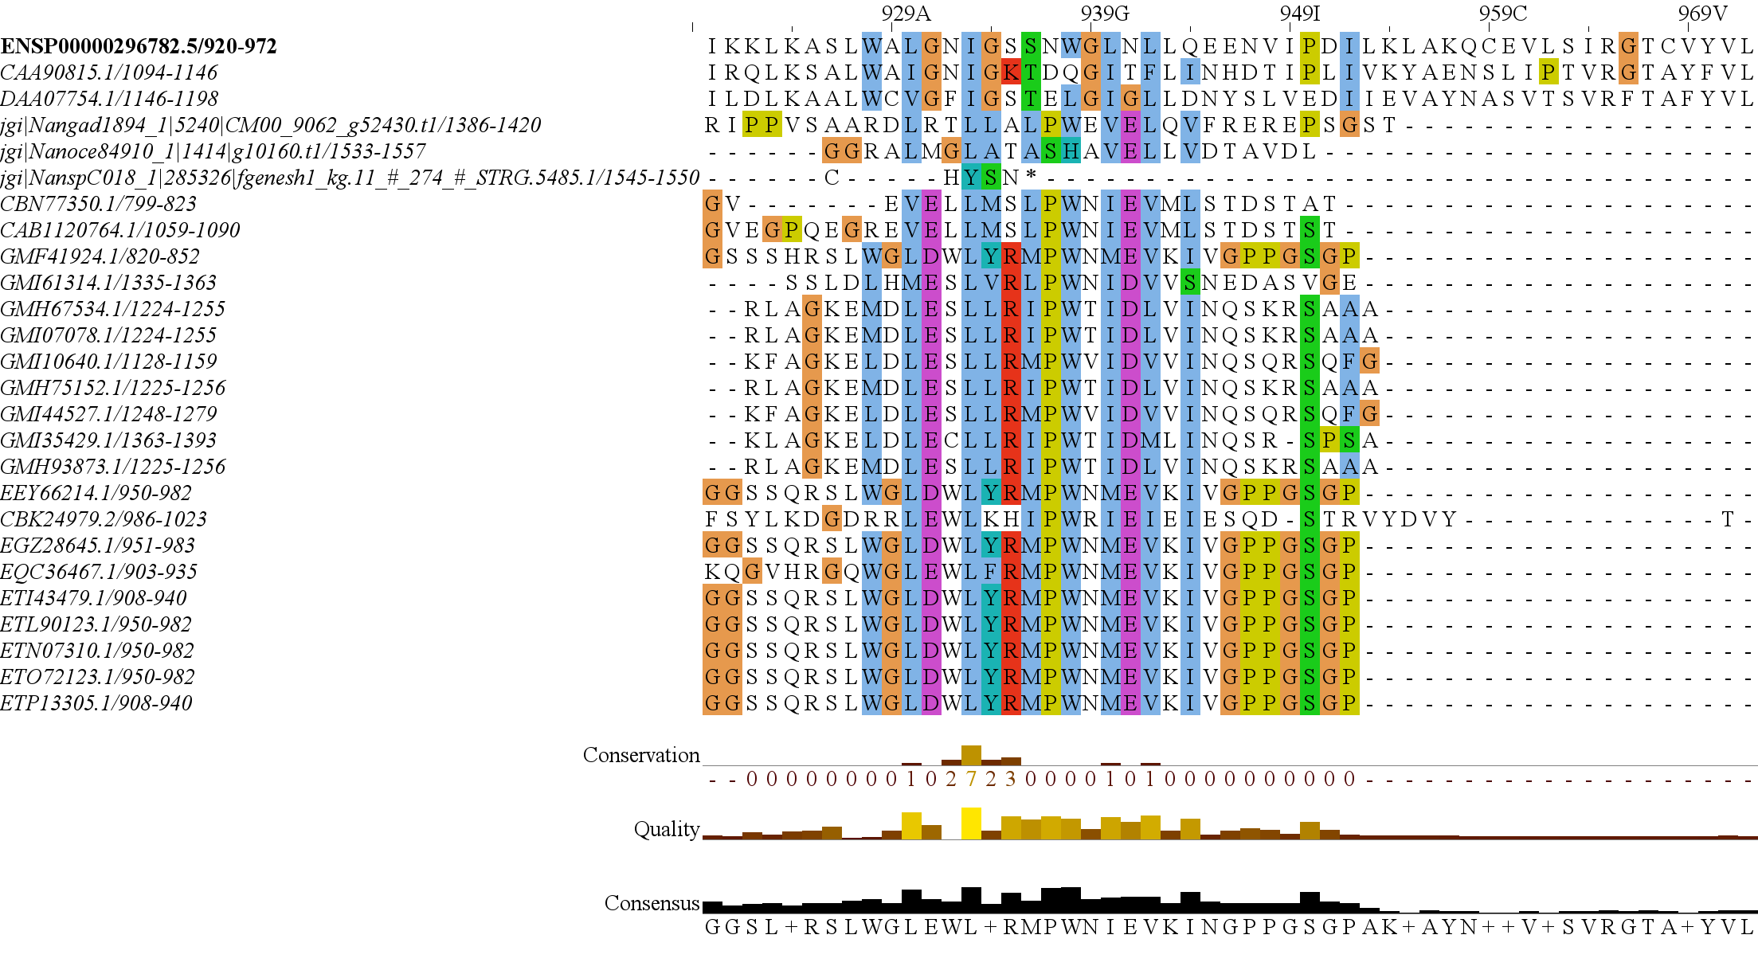
RICTORN
RICTORM
RasGEF
Domain5
RICTOR Phosphorylation
ARM Repeats

Slide 19
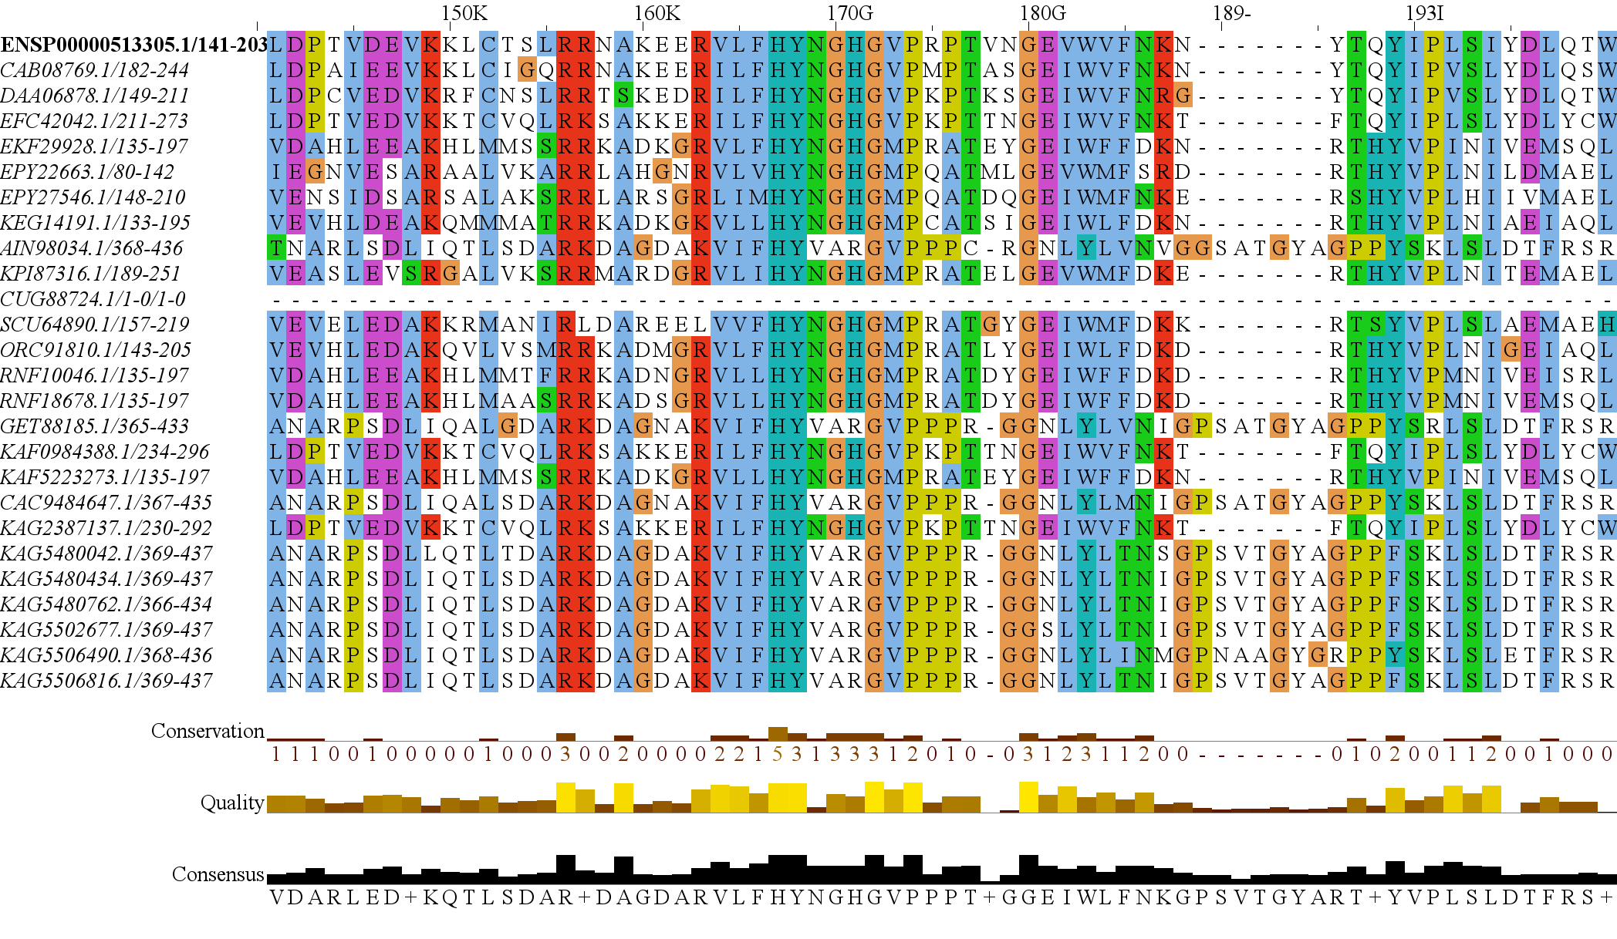
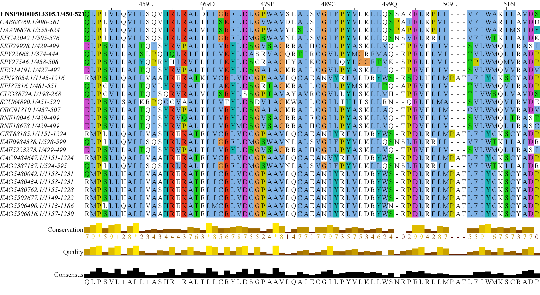
RAPTORN
ARM Repeats
HEAT
ARM Repeats
WD-40 Repeats

Slide 20
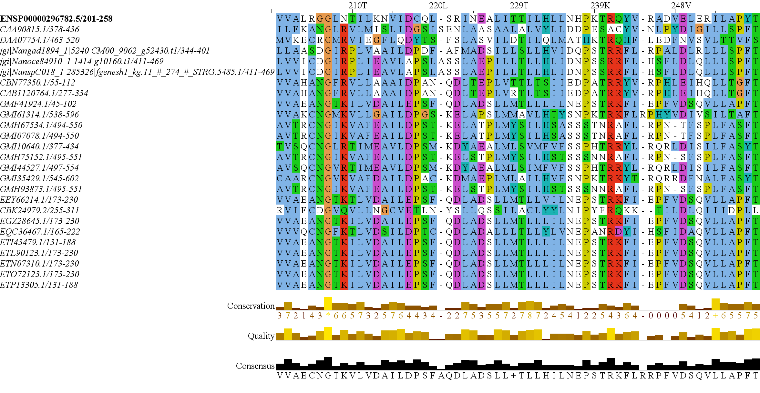
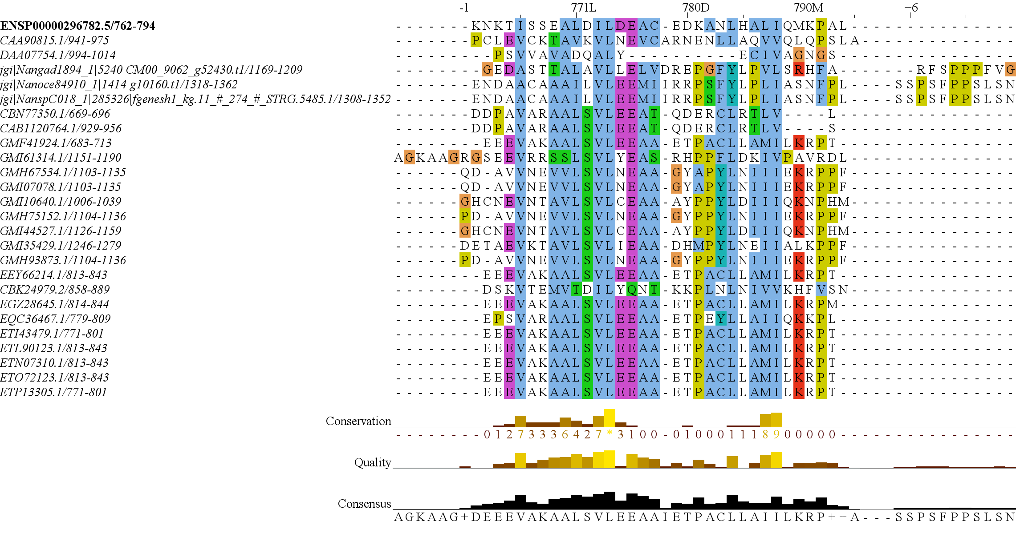
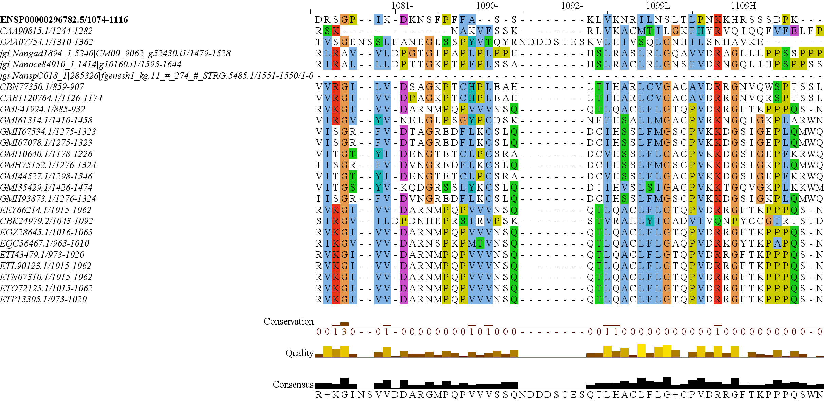
RICTOR N Domain
RICTOR M Domain
RICTOR RasG
RICTOR Phosphorylation Site

Slide 21
Metabolic Strategy Breakdown of Organisms That Have Rictor
Metabolic Strategy Breakdown of Organisms That Don't Have Rictor
Autotroph
7.784 %
Mixotroph
Parasite
0.936 %
19.189 %
Parasite
Heterotroph
37.126 %
1.872 %
Endosymbiote
Heterotroph
1.872 %
Autotroph
46.108 %
76.131 %
Mixotroph
8.982 %

Slide 22
SARs gain of plastids and the losses of TOR Complexes
Rhodophyta Endosymbiosis
Bacillariophyta
TORC2 Lost
PX Clade
Stramenopila
Eustigmatales, etc.
Oomycetes, etc.
Expected Heterotrophic Ancestor
TORC1 & TORC2 Present
Stramenopile Endosymbiosis
Dinophyceae
Chromera, Vitrella
Alveolata
Apicomplexa
Ciliates, etc.
Photoautorophy Loss
Granofilosa
TORC1 and TORC2 Lost
Chlorarachnea
TORC1 Lost
Rhizaria
Chlorophyta Endosymbiosis
Endomyxa, etc.

Slide 23
Simplified Excavata Gain of Plastids
Chlorophyta Endosymbiosis
Euglenophyceae
Discoba
Kinetoplastea
Eutetramitia, etc.
Expected Heterotrophic Ancestor
TORC1 & TORC2 Present
Metamonada

Slide 24
Granofilosa
Reticulofilosa
Filosa
Chlorarachnea
Cercozoa
Monadofilosa
Endomyxa, etc
Rhizaria
Chlorophyta Endosymbiosis
Retaria

